Slide 1
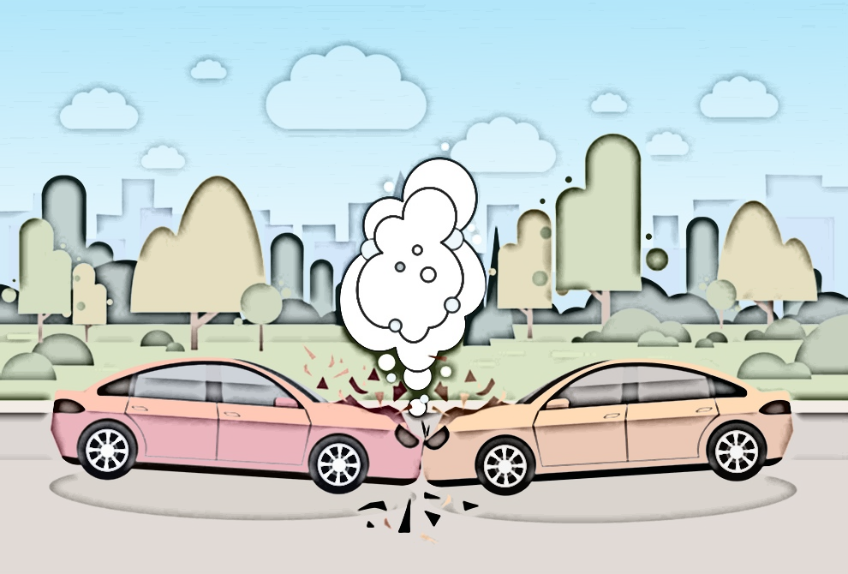
Car Collision Detection

Slide 2
TEAM Members
Mohamed Magdi
Esraa Hazem
Amr Eid
Mohamed Sebaie

Slide 3
AGENDA
01
02
03
04
05
06
Tried Methods
Violent flow model
3D Convolution
Rule based
Yolo v4 – deepsort – VIF
Results
Future work
conclusions

Slide 4
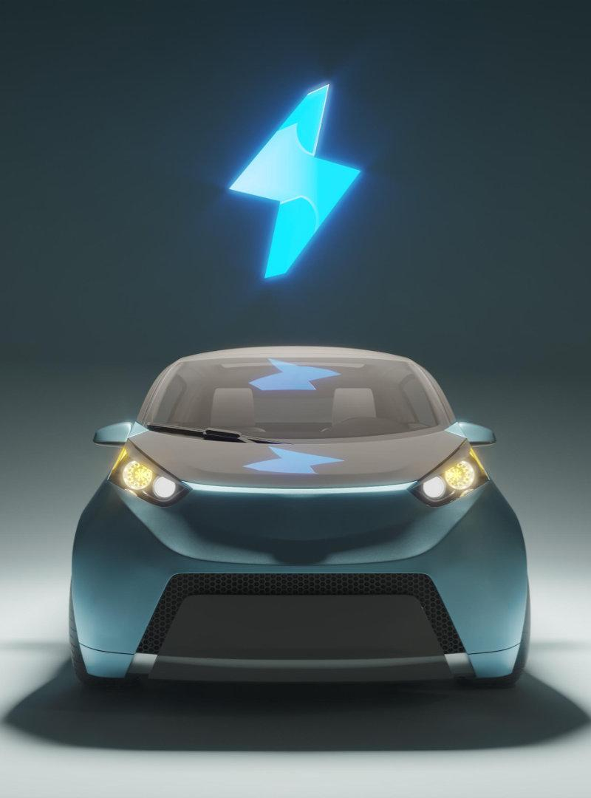
01
Tried methods

Slide 5
Yolo v3, deep sort, Rule based
Yolo v3 was the used method to detect cars. Deep sort was used for tracking.
Rule based to detect accident dependent on feature extraction:
C1: The overlap of bounding boxes of vehicles
C2: Determining Trajectory and their angle of intersection
C3: Determining Speed and their change in acceleration

Slide 6
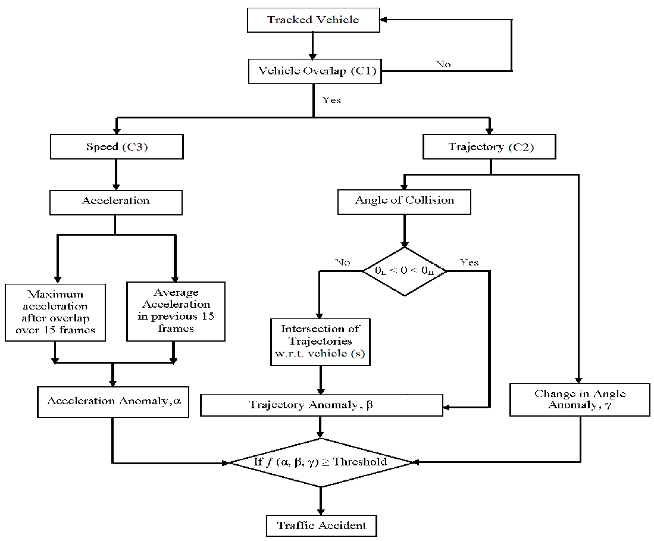
Accident Detection:
1) Acceleration Anomaly, α
2) Trajectory Anomaly, β
3) Change in Angle Anomaly, ϒ

Slide 7
yolo v3 and deep sort
01
02
03
Challenges
Occlusion
(Id Switch)
Struggles to detect small objects.
The detected object could loss the original id and get new id

Slide 8
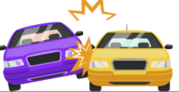
In Rule based
Challenges
01
02
Each rule needs specific threshold to detect the abnormal event
Concatenation of the effect of each rule to detect the accident

Slide 9
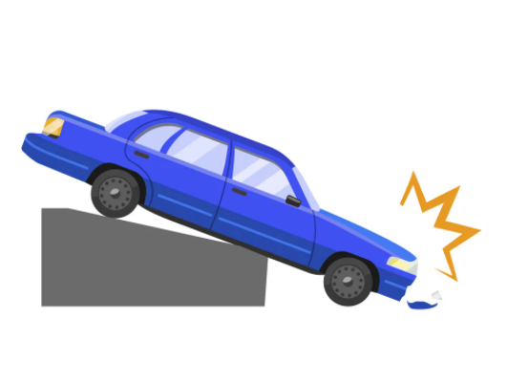
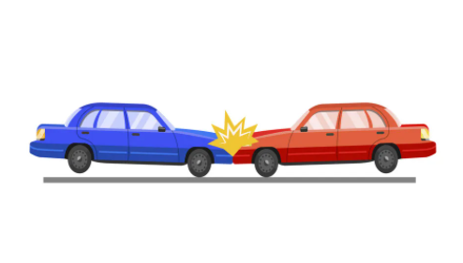
Our work
Violent flow model
3D convolution
Based on the object
Based on scene

Slide 10
02
Violent flow model

Slide 11
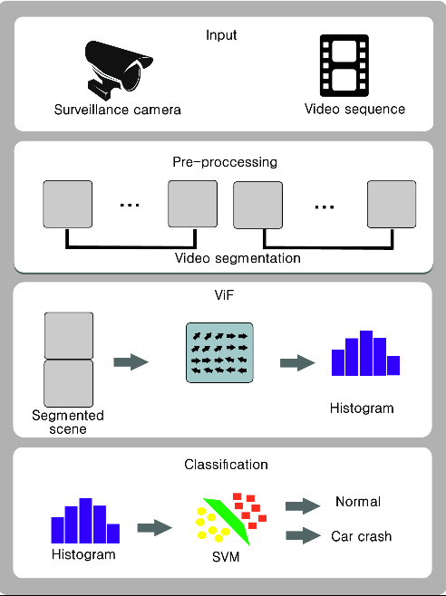
Our pipeline
The project has 3 main stages :
Segmentation .
Compute violent flow .
Support vector machine (SVM).

Slide 12
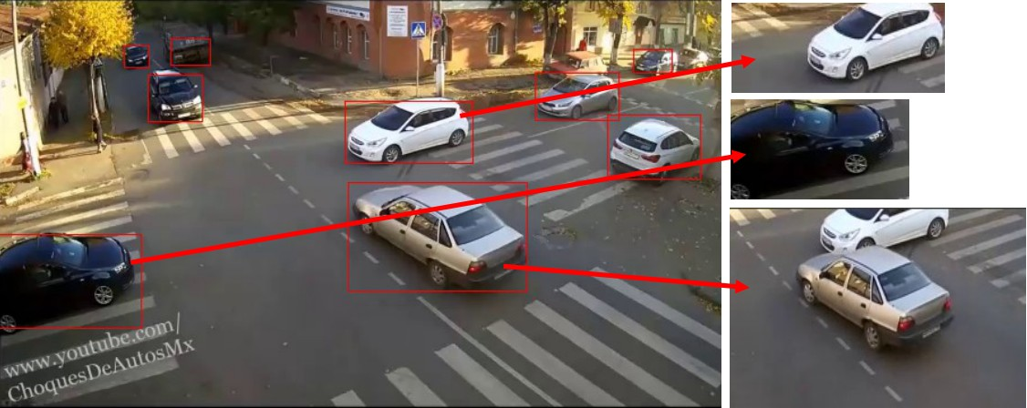
Cars Segmentation
Detect cars using yolo_V4 .
Tracking each car(Deep Sort) .
Making trajectory for each car .
check for similarity
Create video of smaller cars 30F

Slide 13
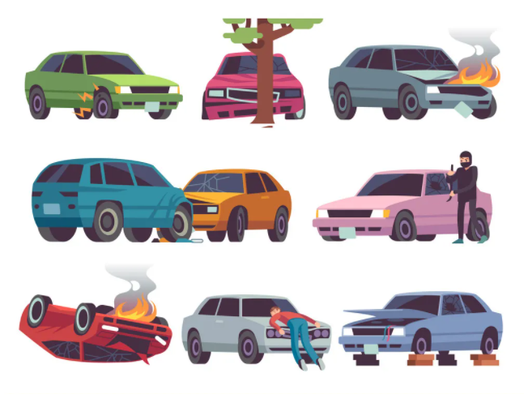
Dataset

Slide 14
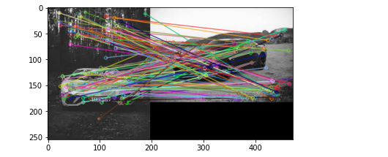
For each frame in accident videos:
Crop each object from frame dependent on boundary box from the tracker
Save cropped objects according to the id from the tracker
Use the similarity between frames to confirm the id of each object
Save the sequence of each object for each 30 frames in a train video
Label the train videos to accident or not accident

Slide 15
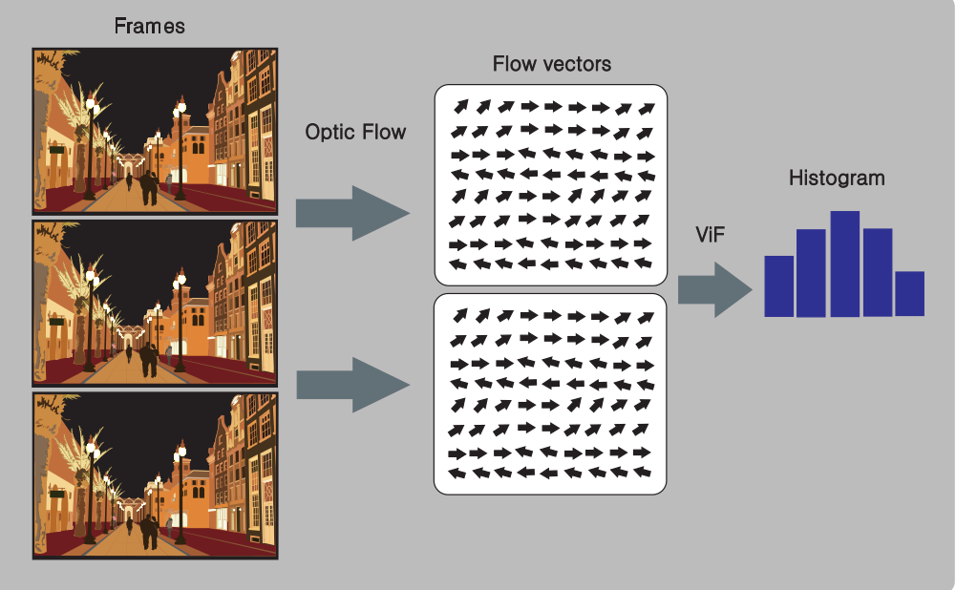
Compute Vif
Vif steps :
Compute dense opticalFlow
Extract flow vectors
Make histograms

Slide 16
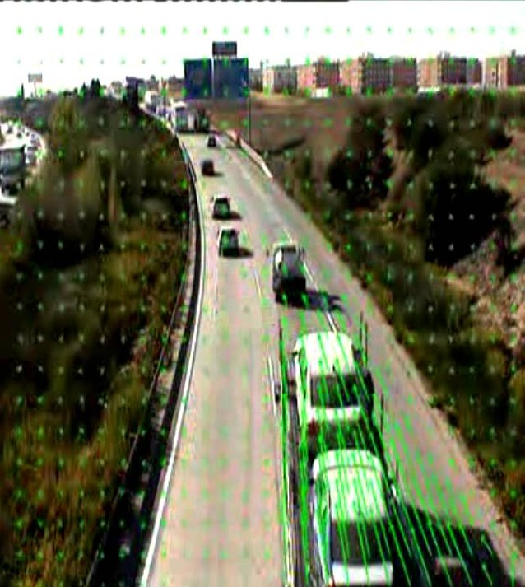
Compute Vif
Vif steps :
Compute farneback optical flow
Extract flow angles , magnitude
Compute angles histogram 18 bins
Compute gradients histogram 18 bins
Merge angles and magnitude hist
Get mean of Vif over 30 frames

Slide 17
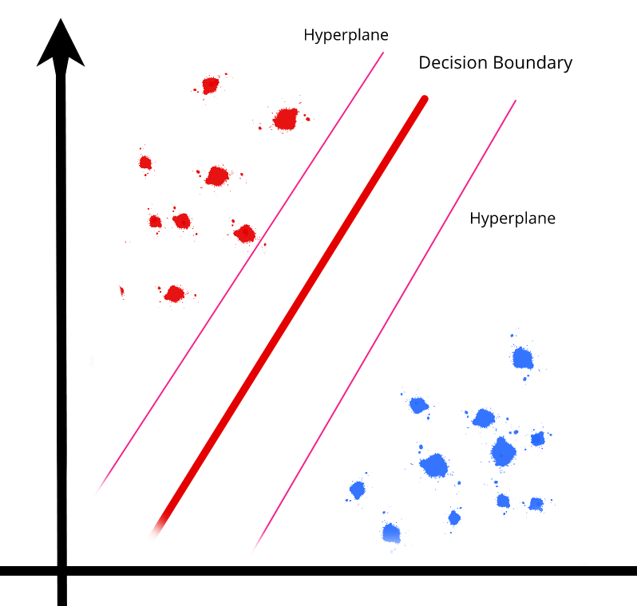
Train and evaluate Classifier
Extract segmented videos
Compute vif for each video
Label each videos acc or no_acc
Train and evaluate SVM and XGboost

Slide 18
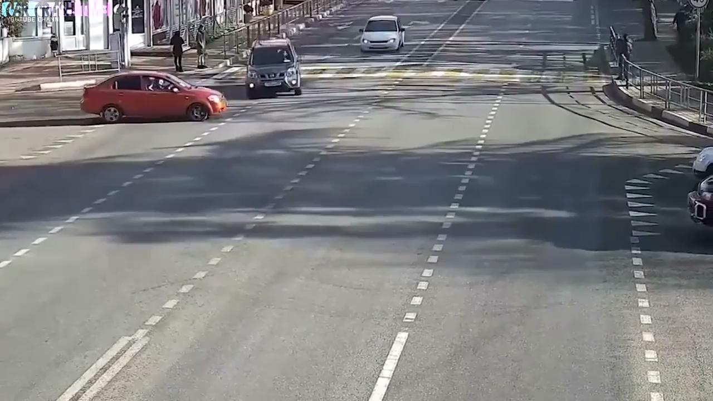
Here’s the scenario
Input video from CCTV

Slide 19
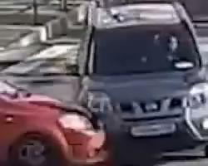
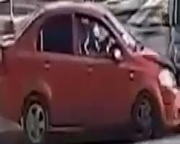
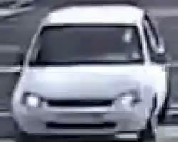
Here’s the scenario
Segmentation of video

Slide 20
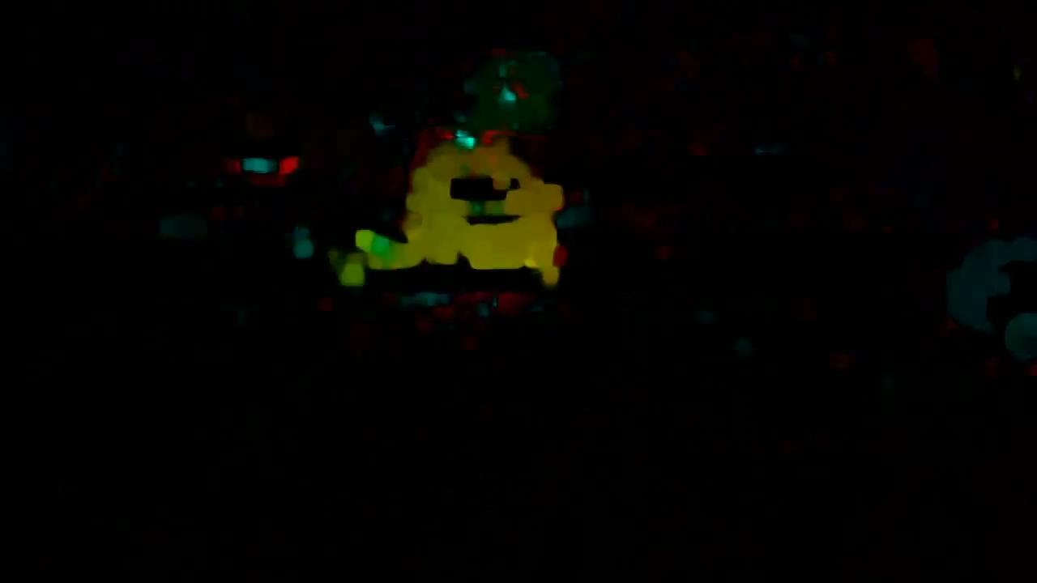
Here’s the scenario
Dense Optical flow Vector using farneback algorithm

Slide 21
03
3D Convolution

Slide 22
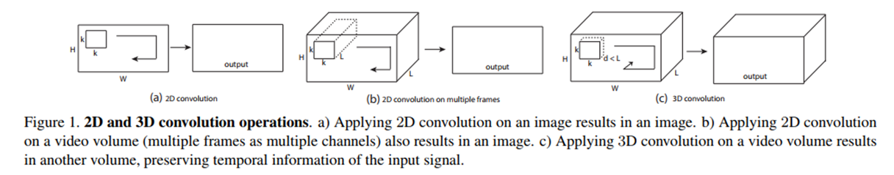
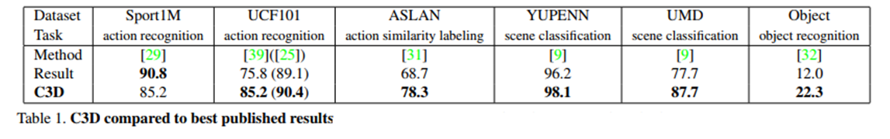
3D Convolution
Learning Spatiotemporal Features with 3D Convolutional Networks (Facebook AI) 2015
“Only the Slow Fusion model (Google Research)2014 uses 3D convolutions and averaging pooling in its first 3 convolution layers. We believe this is the key reason why it performs best among all networks studied. However, it still loses all temporal information after the third convolution layer.”

Slide 23
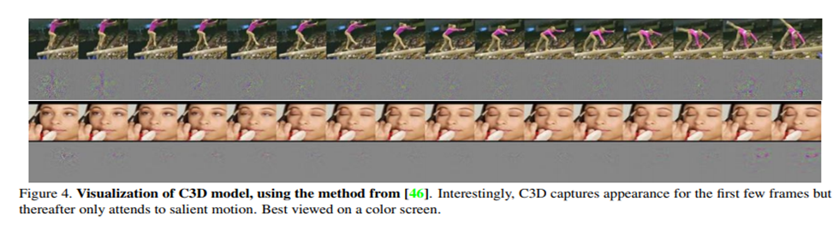
3D Convolution
What does C3D learn? C3D starts by focusing on appearance in the first few frames and tracks the salient motion in the subsequent frames.
Thus, C3D differs from standard 2D ConvNets in that it selectively attends to both motion and appearance. We provide more visualizations in the supplementary material to give a better insight about the learned feature.
M. Zeiler and R. Fergus. Visualizing and understanding convolutional networks. In ECCV, 2014
Accident Recognition via 3D CNNs for Automated Traffic Monitoring in Smart Cities (GTA Videos)M. Bortnikov, A. Khan, A. M. Khattak, and M. Ahmad, “Accident recognition via 3d cnns for automated traffic monitoring in smart cities,” Advances in Intelligent Systems and Computing, vol. 944, pp. 256–264, 2019.
E. Batanina, “Domain adaptation for car accident detection in videos,” in Proceedings of the 2019 Ninth International Conference on Image Processing Theory, Tools and Applications (IPTA), Istanbul, Turkey, November 2019

Slide 24
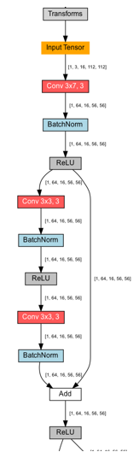
ResNet 3D Convolution
Training Techniques | Weight Decay, SGD with Momentum
Architecture | 1x1 Convolution, Bottleneck Residual Block, Batch Normalization, 3D Convolution, Global Average Pooling, Residual Block, Residual Connection, ReLU, Max Pooling, SoftMax
ID | r3d_18
LR | 0.01
Epochs | 45
Momentum | 0.9
Batch Size | 16

Slide 25
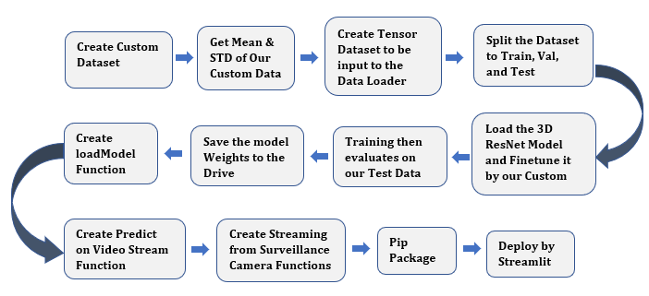
3D Convolution Pipeline
Call Create dataset function that take the videos with labels and return two tensors, one for features(x) is 5d [98, 3, 15, 112, 112] and the another for labels (y) 1d [98]

Slide 26
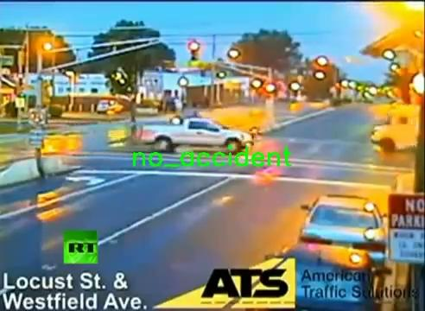
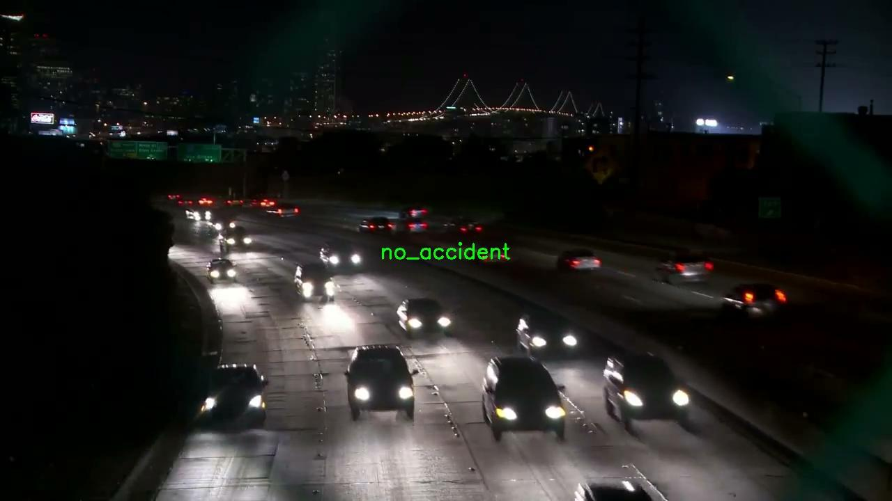
3D Convolution Output
It took 5.211 minutes to predict 26 videos

Slide 27
04
Results

Slide 28
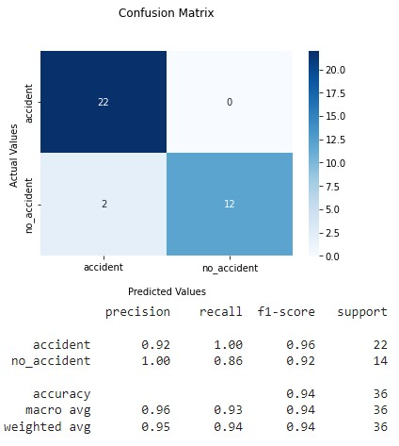
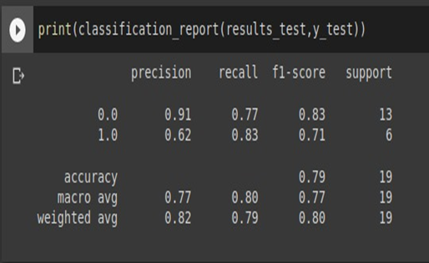
Results using VIF & 3D_Convolution
By using 70 video for train and 19 video for test balanced data
By using 88 video for Train , Validation and 36 video for test
SVM results:

Slide 29
Comparison with previous work
Approach | DR % | FAR %
MASK R-CNN(MASK R-CNN/centroid based tracking) | 71 | 0.53
Vision based(GMM/mean shift) | 50 | 0.004
Deep spatio-temporal | 77.53 | 22.5
Mixed Traffic Flow(YOLO/decision tree-based framework) | 92.5 | 7.5
our first method Violent flow (SVM) | 62 | 17
our Second Method 3D convolution (3D ResNet_18) | 92 | 0
!!!! Based on accident class detection

Slide 30
05
Future work

Slide 31
VIF :
Improving tracking accuracy for by using a mix of different multi-object trackers
Get more videos to make larger dataset .
Deploy the model to work on Raspberry pi or nvidia jetson .
Try improve the features accuracy by using weber_descriptors instead of Vif

Slide 32
3D COnvolution:
Introduced attention module into residual neural networks to improve the performance of detecting local appearance features and linked ResNet with Conv- LSTM model to simultaneously capture crashes’ appearance and motion features.
a Domain adaptation (DA) transfer learning applied to the real-world condition to increase the training data.

Slide 33
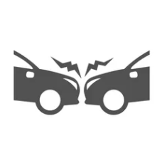


Slide 34
References
https://drive.google.com/file/d/1QxQ_XlwRnfS6c7dKTyXv8hk0zfLeU13P/view?usp=sharing
https://drive.google.com/file/d/1yFNnUdIQQ-M_PaYlX_JSgsUrwV9PdONI/view?usp=sharing
https://pytorch.org/hub/facebookresearch_pytorchvideo_resnet/
https://www.researchgate.net/publication/332622984_Accident_Recognition_via_3D_CNNs_for_Automated_Traffic_Monitoring_in_Smart_Cities
https://ieeexplore.ieee.org/abstract/document/8936124

Slide 35
THANKS

